Slide 1

Unlocking the Power of AI: A Journey into Data Analytics and Innovation

Slide 2
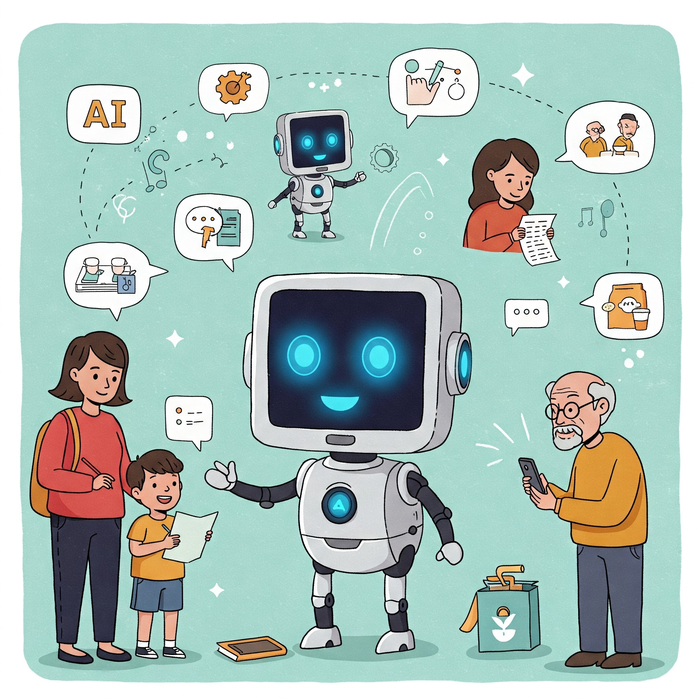
Artificial Intelligence (AI) Unveiled
What’s It About? AI is like a super-smart helper! It can turn off your home’s lights when you leave, turn them on when you’re back, let you shop by talking to a device, or unlock your phone with just your face.
Why It’s Cool: A few years ago, this was movie stuff—now it’s normal! Robots aren’t chatting with us yet, but everyday gadgets are getting brainy.
Quick Fact: Experts say AI could be a $500 billion industry by 2025—huge, right?

Slide 3
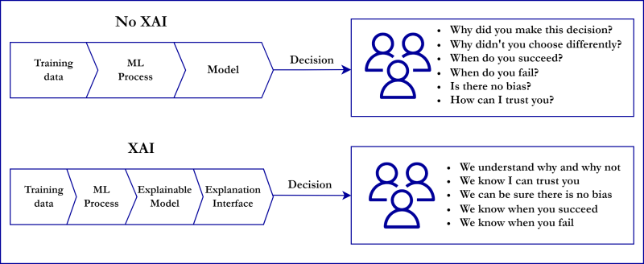
WHAT IS EXPLAINABLE AI?
Dive In: Explainable AI (XAI) is AI that tells you *why* it does things—like why it thinks a photo has a cat or a machine part is broken.
Why It Matters: Regular AI can feel like a mystery box. XAI opens it up so you trust it, especially for big decisions like fixing a power plant.
Beginner Bonus: Think of it as a friend explaining their homework answer not just giving you the result.

Slide 4
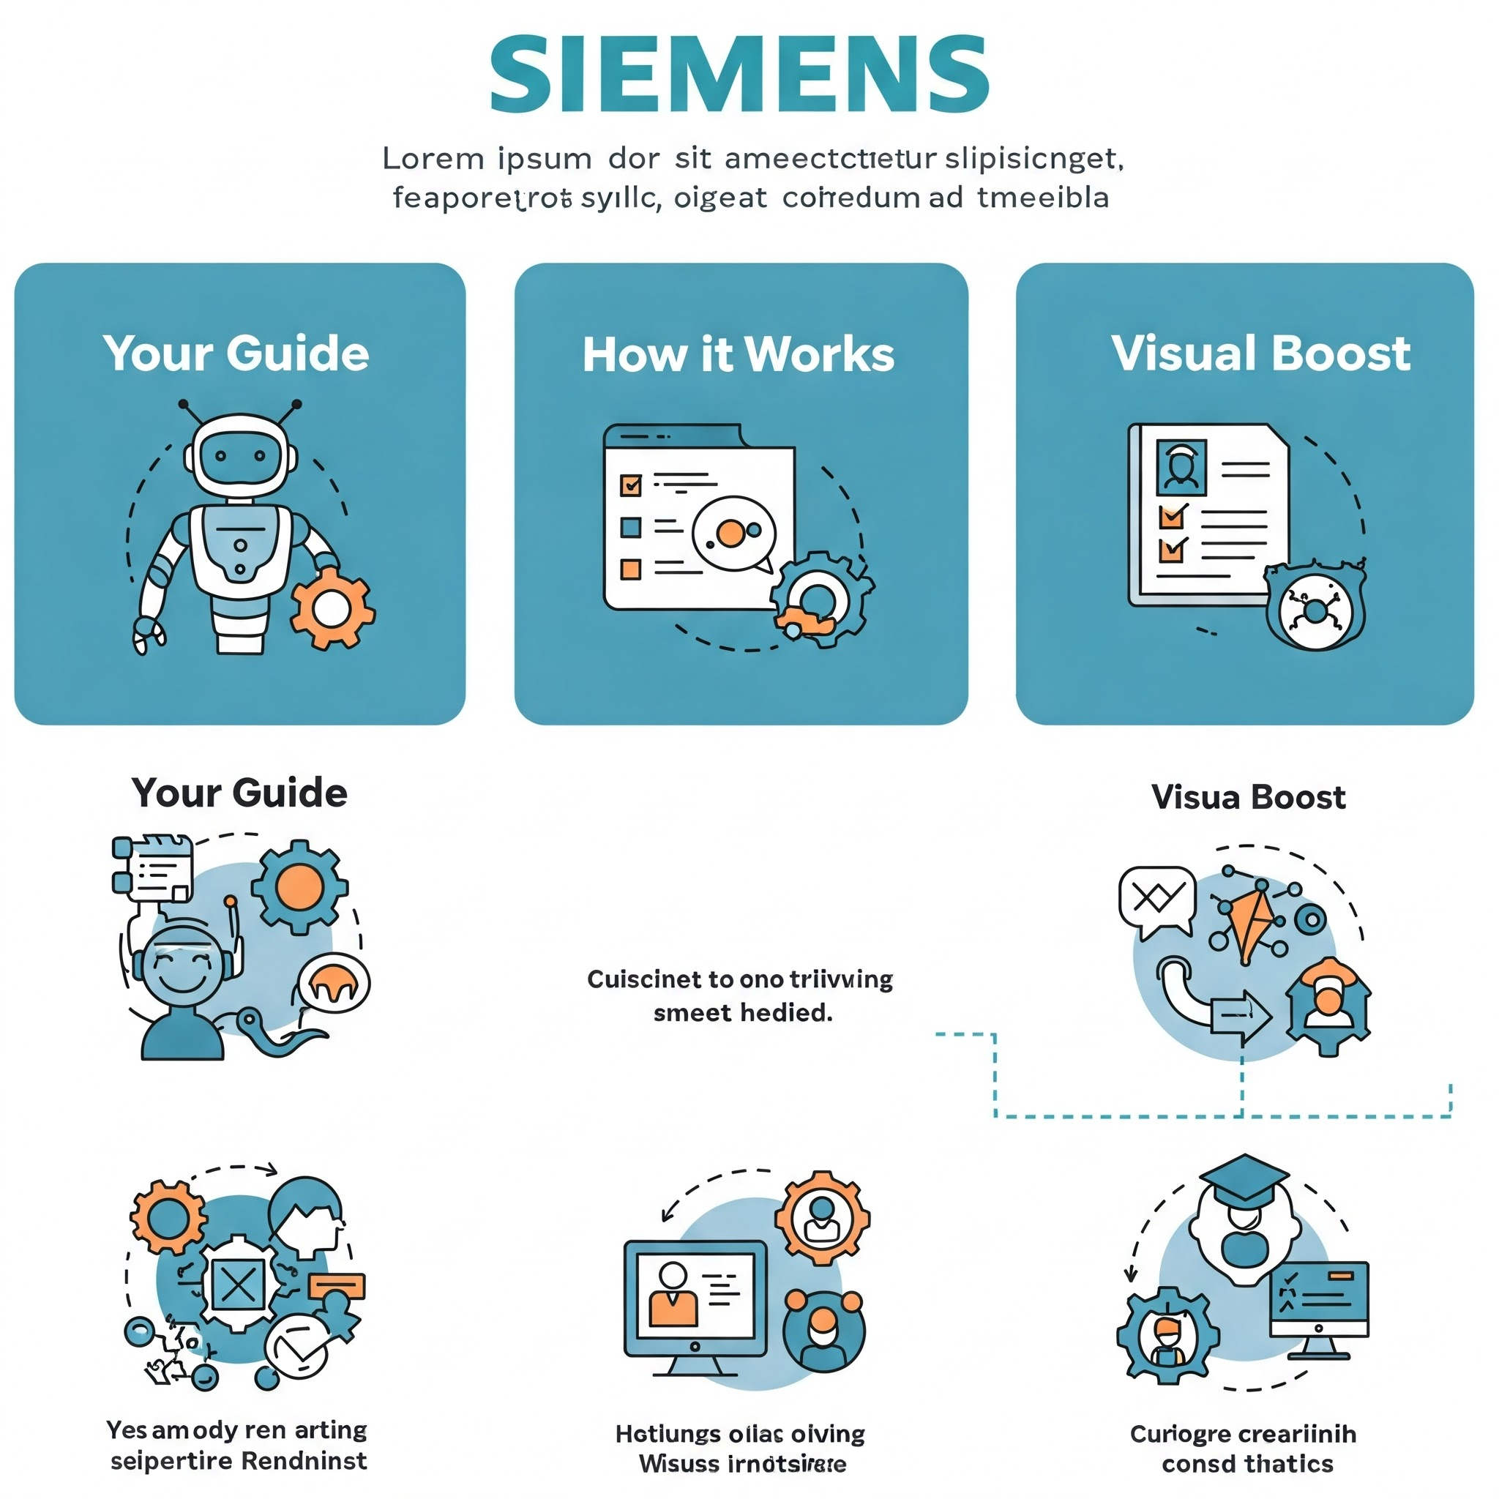
YOUR EXPLAINABLE AI ROADMAP
Your Guide: The whole training on Ai is split into small “learning nuggets”—like mini-lessons—so it’s not overwhelming.
How It Works: Newbies can follow step-by-step; pros can skip to what they like. Each nugget builds your AI know-how.
Visual Boost: Pictures and charts (e.g., a map of topics) make it easy to see the big picture.

Slide 5
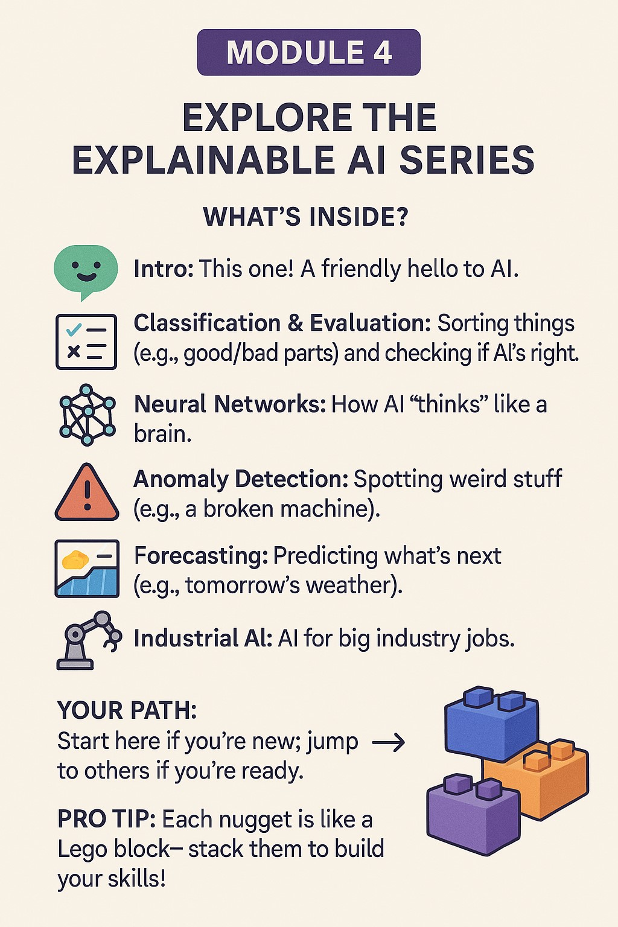
EXPLORE THE Explainable ai series

Slide 6
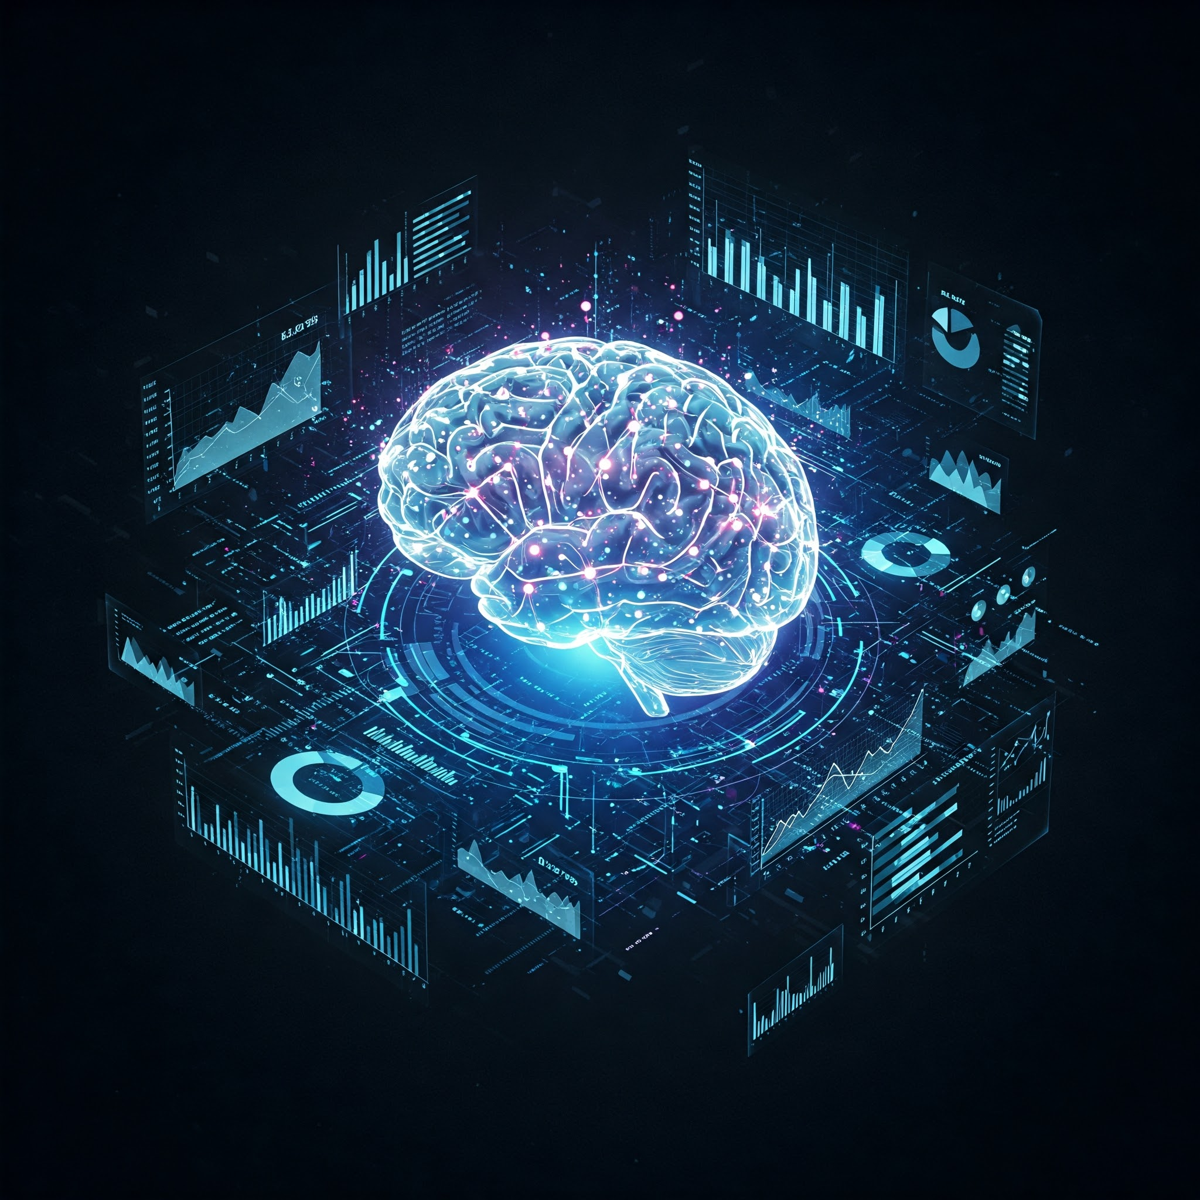
Data analytics and Artificial Intelligence
Core Idea: AI is smart, but it needs data (information) to work: like how you need food for energy.
Human vs. Machine: Your eyes and ears collect data (example: “it’s hot!”); machines use sensors (example: temperature readers) to “see” the world.
Think About It: What data do you notice daily (example: weather and time)

Slide 7
Teaching computers to think
Challenge: Imagine teaching a computer to spot a dog in a photo—tricky, right? That’s what this is about!
Two Paths: You can give it exact rules or let it learn by itself (we’ll explain both soon).
Beginner Bonus: It’s like teaching a kid—either tell them “dogs have fur” or show them dog pics till they get it.

Slide 8
MACHINE PROGRAMMING- RULES RULE!
How It Works:
An expert says, “If the oven’s over 200°C, turn it off.”
A coder writes that rule in computer language.
The machine follows it exactly.
Pros: Super clear—like a recipe—and works every time.
Cons: Hard for messy tasks (e.g., “Is this voice happy or sad?”).
Example: Think of a thermostat—it’s programmed to keep your room cozy.
DATA
WRITE A PROGRAM BASED ON PROCESS
KNOWLEDGE REPRESENTED IN MACHINE
MACHINE PROGRAMMING

Slide 9
MACHINE LEARNING-LEARN BY EXAMPLES
How It Works:
Show the computer pics: “This is a cat, this isn’t.” It studies them and learns the difference.
Uses special tools (algorithms) to find patterns—like spotting whiskers or tails.
Cool Example: Self-driving cars learn roads by “watching” millions of drives.
Key Need: Lots of examples and a smart system to crunch them.
Beginner Bonus: It’s like training a puppy with treats, it figures things out over time!
DATA WITH RIGHT ANSWERS
COMPUTER LEARNS FROM EXAMPLE
KNOWLEDGE REPRESENTED IN MACHINE
MACHINE LEARNING

Slide 10
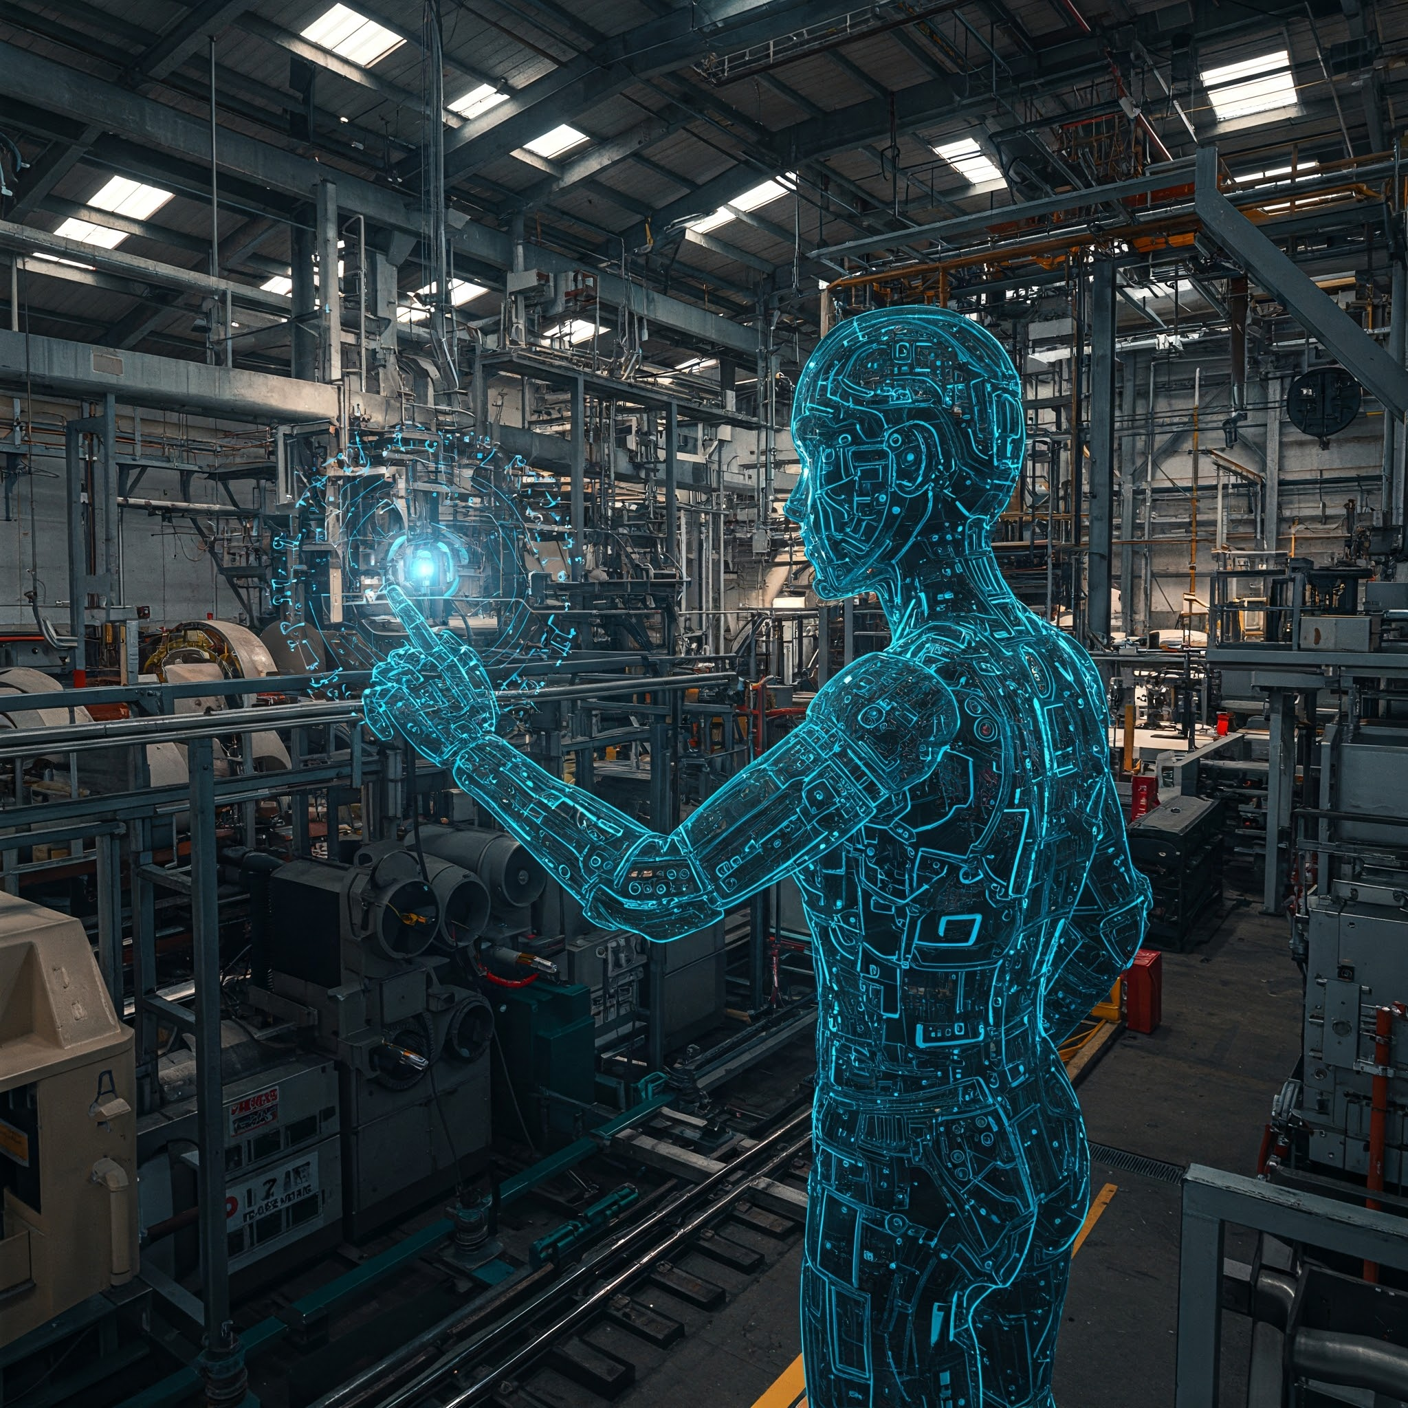
INDUSTRIAL AI- BEYOND GADGETS
What’s Unique? This is AI for big stuff—factories, trains, power plants—not just your phone.
Focus: Keeps things safe, fast, and working well (e.g., no factory shutdowns).
Beginner Bonus: Think of it as a super mechanic with X-ray vision.

Slide 11
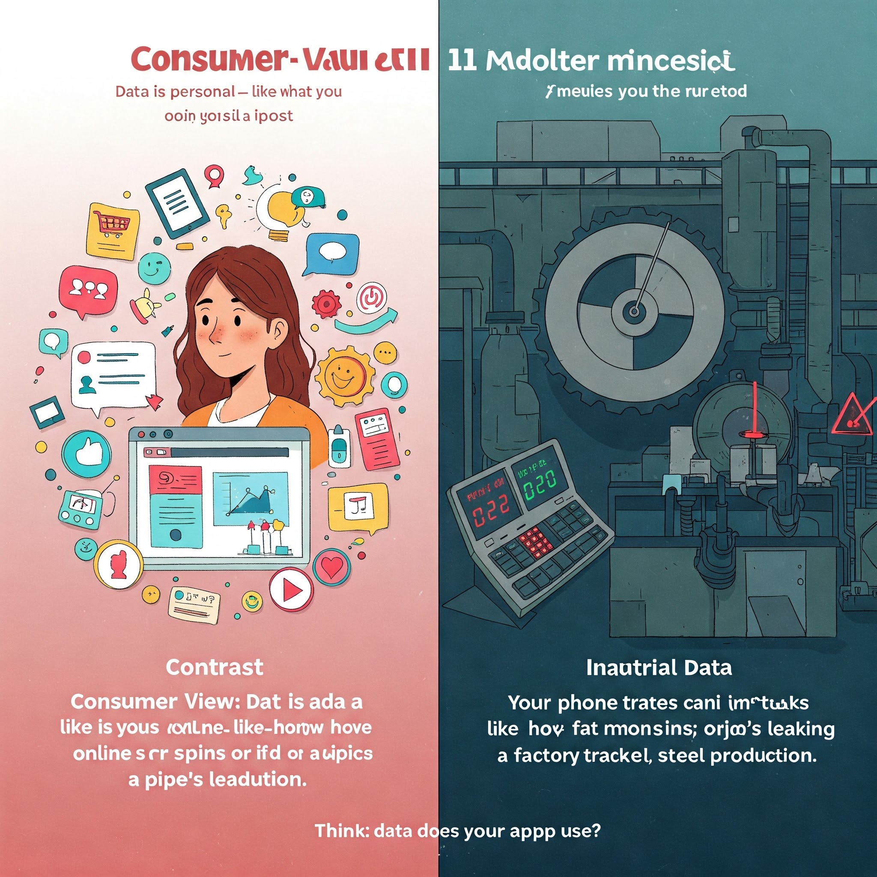
CONSUMER DATA MINDSET
Consumer View: Data is personal—like what you buy online or post on social media.
Contrast: Industrial data is about machines—like how fast a motor spins or if a pipe’s leaking.
Example: Your phone tracks your steps; a factory tracks steel production.
Think: What data does your favorite app use?

Slide 12
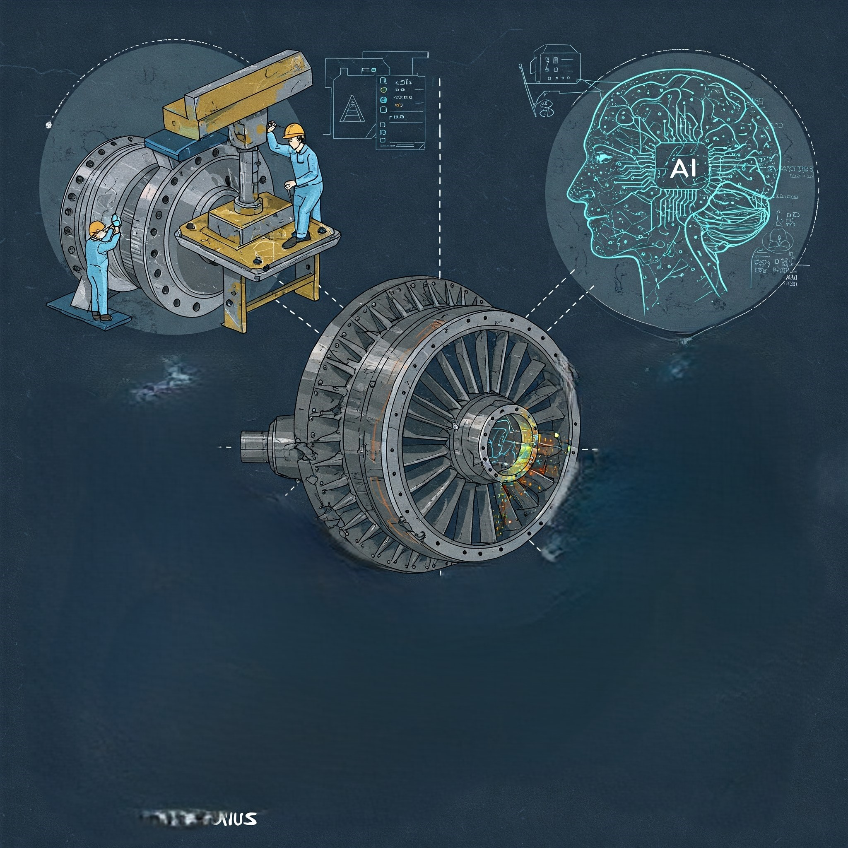
INDUSTRIAL AI: CHALLENGES AND WINS
Tough Stuff:
Hard to get examples - only experts know if a machine part’s bad, and those examples are rare.
Mistakes hurt - a wrong store suggestion is no biggie, but a broken turbine cost million.
Beginner Bonus: It’s like training a doctor—needs lots of practice and no room for error.
Example: AI spots a tiny crack in a plane engine—huge save!

Slide 13
Ready to launch your ai journey?
Why Start?
Get savvy with a top tech trend—AI’s everywhere!
Use AI to fix your problems (e.g., plan better at work).
Just curious? Learn how this cool stuff works!
Next Step: Dig into these nuggets—pick one that grabs you.
Fun Fact: AI skills are a 2025 job must-have (says the World Economic Forum).
Let’s Go: What’s your first AI adventure?

Slide 14
Slide Tite
We are going to have a great learning together!

